Slide 1


Android Custom Drawable

Slide 2
Custom Button Shape in Android
Android provide many of standard views such as Button, TextView and ImageView
Using Shape drawable we can create custom shapes. Shape drawables provide this basic shapes: Rectangle, Oval, Line, and Ring.
This all shapes have this below attributes:
gradient: For gradient backgrounds
solid: For solid background color
padding: For padding between the edge of the shape and its contents
size: For the width and height
stroke: For a stroke line around the edge of the shape
Let’s see simple example for button shape. Make this xml files in drawable folders, set to button by background attribute.
2

Slide 3
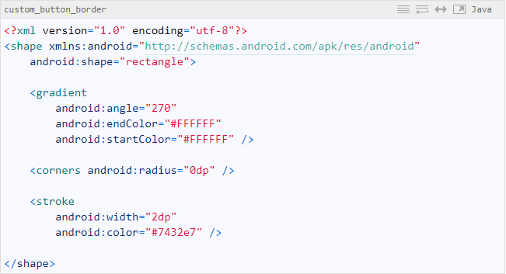
Custom Button Shape in Android
custom_button_border.xml
3

Slide 4
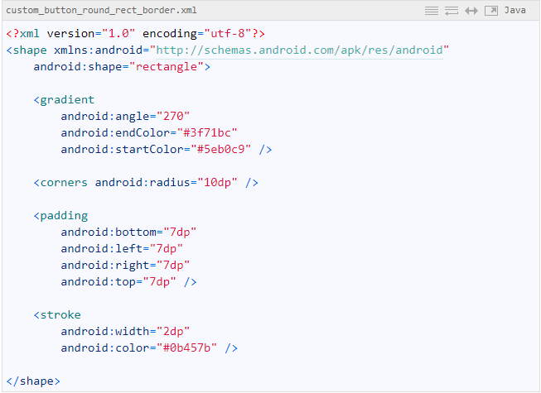
Custom Button Shape in Android
custom_button_round_rect_border.xml
4

Slide 5
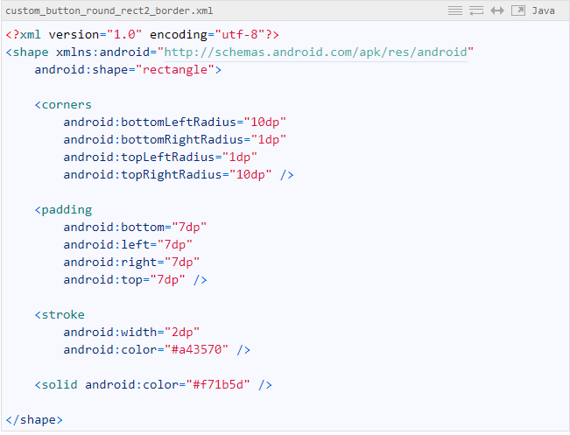
Custom Button Shape in Android
custom_button_round_rect2_border.xml
5

Slide 6
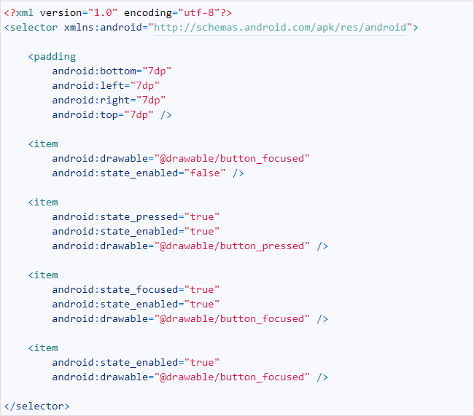
Custom Button Shape in Android
custom_button_press_effect.xml
6

Slide 7
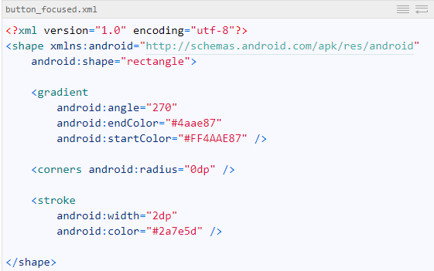
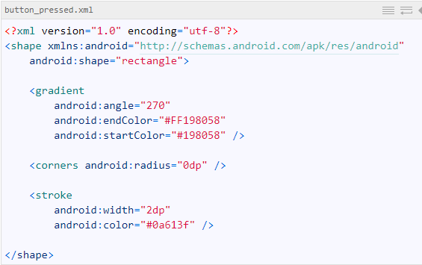
Custom Button Shape in Android
You can create all effect as per requirement, I have create just two effect for sample. button_focused.xml for when button is focused or button_pressed.xml for when button pressed
7

Slide 8
Android Multi-Threading

Slide 9
13. Android – Multi-Threading
Multi-Threading
Threads
There are basically two main ways of having a Thread execute application code.
One is providing a new class that extends Thread and overriding its run() method.
The other is providing a new Thread instance with a Runnable object during its creation.
In both cases, the start() method must be called to actually execute the new Thread.
9

Slide 10
13. Android – Multi-Threading
Multi-Threading
Handler Class
There are two main uses for a Handler:
to schedule messages and runnables to be executed as some point in the future; and
to enqueue an action to be performed on another thread
10

Slide 11
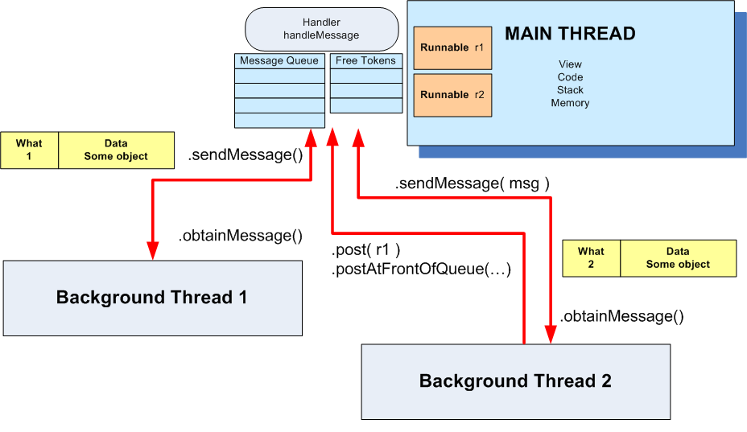
13. Android – Multi-Threading
Multi-Threading
11

Slide 12
13. Android – Multi-Threading
Multi-Threading
Using Messages
Main Thread | Background Thread
... Handler myHandler = new Handler() { @Override public void handleMessage(Message msg) { // do something with the message... // update GUI if needed! ... }//handleMessage };//myHandler ... | ... Thread backgJob = new Thread (new Runnable (){ @Override public void run() { //...do some busy work here ... //get a token to be added to //the main's message queue Message msg = myHandler.obtainMessage(); ... //deliver message to the //main's message-queue myHandler.sendMessage(msg); }//run });//Thread //this call executes the parallel thread backgroundJob.start(); ...
v
12

Slide 13
13. Android – Multi-Threading
Multi-Threading
Using Post
Main Thread | Background Thread
... Handler myHandler = new Handler(); @Override public void onCreate( Bundle savedInstanceState) { ... Thread myThread1 = new Thread(backgroundTask, "backAlias1"); myThread1.start(); }//onCreate ... //this is the foreground runnable private Runnable foregroundTask = new Runnable() { @Override public void run() { // work on the UI if needed } ... | // this is the "Runnable" object // that executes the background thread private Runnable backgroundTask = new Runnable () { @Override public void run() { ... Do some background work here myHandler.post(foregroundTask); }//run };//backgroundTask
13

Slide 14
13. Android – Multi-Threading
Multi-Threading
Messages
To send a Message to a Handler, the thread must first invoke obtainMessage() to get the Message object out of the pool.
There are a few forms of obtainMessage(), allowing you to just create an empty Message object, or messages holding arguments
Example
// thread 1 produces some local data
String localData = “Greeting from thread 1”;
// thread 1 requests a message & adds localData to it
Message mgs = myHandler.obtainMessage (1, localData);
14
14

Slide 15
13. Android – Multi-Threading
Multi-Threading
sendMessage Methods
You deliver the message using one of the sendMessage...() family of methods, such as …
• sendMessage() puts the message at the end of the queue immediately
• sendMessageAtFrontOfQueue() puts the message at the front of the queue
immediately (versus the back, as is the default), so your message takes
priority over all others
• sendMessageAtTime() puts the message on the queue at the stated
time, expressed in the form of milliseconds based on system uptime
(SystemClock.uptimeMillis())
• sendMessageDelayed() puts the message on the queue after a delay,
expressed in milliseconds
15
15

Slide 16
13. Android – Multi-Threading
Multi-Threading
Processing Messages
To process messages sent by the background threads, your Handler needs to implement the listener
handleMessage( . . . )
which will be called with each message that appears on the message queue.
There, the handler can update the UI as needed. However, it should still do that work quickly, as other UI work is suspended until the Handler is done.
16
16

Slide 17
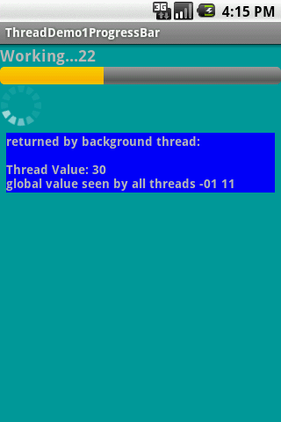
13. Android – Multi-Threading
Multi-Threading
Example 1. Progress Bar – Using Message Passing
The main thread displays a horizontal and a circular progress bar widget showing the progress of a slow background operation. Some random data is periodically sent from the background thread and the messages are displayed in the main view.
<?xml version="1.0" encoding="utf-8"?>
<LinearLayout
android:id="@+id/widget28"
android:layout_width="fill_parent"
android:layout_height="fill_parent"
android:background="#ff009999"
android:orientation="vertical"
xmlns:android="http://schemas.android.com/apk/res/android"
>
<TextView
android:id="@+id/TextView01"
android:layout_width="fill_parent"
android:layout_height="wrap_content"
android:text="Working ...."
android:textSize="18sp"
android:textStyle="bold" />
<ProgressBar
android:id="@+id/progress"
android:layout_width="fill_parent"
android:layout_height="wrap_content"
style="?android:attr/progressBarStyleHorizontal" />
<ProgressBar
android:id="@+id/progress2"
android:layout_width="wrap_content"
android:layout_height="wrap_content" />
<TextView
android:id="@+id/TextView02"
android:layout_width="fill_parent"
android:layout_height="wrap_content"
android:text="returned from thread..."
android:textSize="14sp"
android:background="#ff0000ff"
android:textStyle="bold"
android:layout_margin="7px"/>
</LinearLayout>
17
17
17

Slide 18
13. Android – Multi-Threading
Multi-Threading
Example 1. Progress Bar – Using Message Passing
// Multi-threading example using message passing
package cis493.threads;
import java.util.Random;
import android.app.Activity;
import android.os.Bundle;
import android.os.Handler;
import android.os.Message;
import android.view.View;
import android.widget.ProgressBar;
import android.widget.TextView;
public class ThreadDemo1ProgressBar extends Activity {
ProgressBar bar1;
ProgressBar bar2;
TextView msgWorking;
TextView msgReturned;
boolean isRunning = false;
final int MAX_SEC = 60; // (seconds) lifetime for background thread
String strTest = "global value seen by all threads ";
int intTest = 0;
18
18
18

Slide 19
13. Android – Multi-Threading
Multi-Threading
Example 1. Progress Bar – Using Message Passing
Handler handler = new Handler() {
@Override
public void handleMessage(Message msg) {
String returnedValue = (String)msg.obj;
//do something with the value sent by the background thread here ...
msgReturned.setText("returned by background thread: \n\n"
+ returnedValue);
bar1.incrementProgressBy(2);
//testing thread’s termination
if (bar1.getProgress() == MAX_SEC){
msgReturned.setText("Done \n back thread has been stopped");
isRunning = false;
}
if (bar1.getProgress() == bar1.getMax()){
msgWorking.setText("Done");
bar1.setVisibility(View.INVISIBLE);
bar2.setVisibility(View.INVISIBLE);
bar1.getLayoutParams().height = 0;
bar2.getLayoutParams().height = 0;
}
else {
msgWorking.setText("Working..." +
bar1.getProgress() );
}
}
}; //handler
19
19
19

Slide 20
13. Android – Multi-Threading
Multi-Threading
Example 1. Progress Bar – Using Message Passing
@Override
public void onCreate(Bundle icicle) {
super.onCreate(icicle);
setContentView(R.layout.main);
bar1 = (ProgressBar) findViewById(R.id.progress);
bar2 = (ProgressBar) findViewById(R.id.progress2);
bar1.setMax(MAX_SEC);
bar1.setProgress(0);
msgWorking = (TextView)findViewById(R.id.TextView01);
msgReturned = (TextView)findViewById(R.id.TextView02);
strTest += "-01"; // slightly change the global string
intTest = 1;
}//onCreate
public void onStop() {
super.onStop();
isRunning = false;
}
20
20
20

Slide 21
13. Android – Multi-Threading
Multi-Threading
Example 1. Progress Bar – Using Message Passing
public void onStart() {
super.onStart();
// bar1.setProgress(0);
Thread background = new Thread(new Runnable() {
public void run() {
try {
for (int i = 0; i < MAX_SEC && isRunning; i++) {
//try a Toast method here (will not work!)
//fake busy busy work here
Thread.sleep(1000); //one second at a time
Random rnd = new Random();
// this is a locally generated value
String data = "Thread Value: " + (int) rnd.nextInt(101);
//we can see and change (global) class variables
data += "\n" + strTest + " " + intTest;
intTest++;
//request a message token and put some data in it
Message msg = handler.obtainMessage(1, (String)data);
// if thread is still alive send the message
if (isRunning) {
handler.sendMessage(msg);
}
}
} catch (Throwable t) {
// just end the background thread
}
}//run
});//background
isRunning = true;
background.start();
}//onStart
} //class
21
21
21

Slide 22
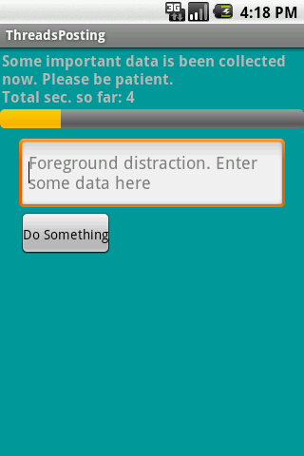
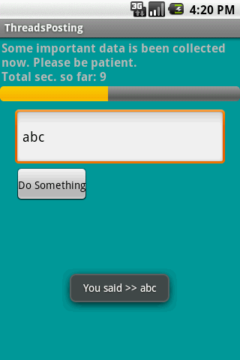
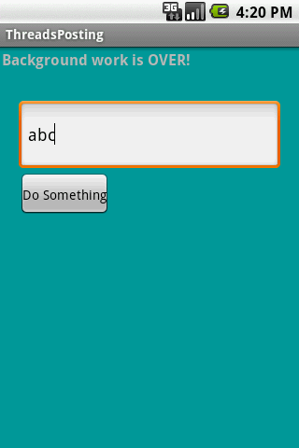
13. Android – Multi-Threading
Multi-Threading
Example 2. Using Handler post(...) Method
We will try the same problem presented earlier (a slow background task and a responsive foreground UI) this time using the posting mechanism to execute foreground runnables.
22
22

Slide 23
13. Android – Multi-Threading
Multi-Threading
Example2. Using Handler post(...) Method
<?xml version="1.0" encoding="utf-8"?>
<LinearLayout
android:id="@+id/linearLayout1"
android:layout_width="fill_parent"
android:layout_height="fill_parent"
android:background="#ff009999"
android:orientation="vertical"
xmlns:android=http://schemas.android.com/apk/res/android >
<TextView
android:id="@+id/lblTopCaption"
android:layout_width="fill_parent"
android:layout_height="wrap_content"
android:padding="2px"
android:text="Some important data is being collected now. Patience please..."
android:textSize="16sp"
android:textStyle="bold" />
<ProgressBar
android:id="@+id/myBar"
style="?android:attr/progressBarStyleHorizontal"
android:layout_width="fill_parent"
android:layout_height="wrap_content" />
<EditText
android:id="@+id/txtBox1"
android:layout_width="fill_parent"
android:layout_height="78px"
android:layout_marginLeft="20px"
android:layout_marginRight="20px"
android:textSize="18sp" android:layout_marginTop="10px" />
<Button
android:id="@+id/btnDoSomething"
android:layout_width="wrap_content"
android:layout_height="wrap_content"
android:padding="4px"
android:layout_marginLeft="20px"
android:text="Do Something" />
</LinearLayout>
23
23

Slide 24
13. Android – Multi-Threading
Multi-Threading
Example2. Using Handler post(...) Method
// using Handler post(...) method to execute foreground runnables
package cis493.threads;
import android.app.Activity;
import android.os.Bundle;
import android.os.Handler;
import android.text.Editable;
import android.view.View;
import android.view.View.OnClickListener;
import android.widget.Button;
import android.widget.EditText;
import android.widget.ProgressBar;
import android.widget.TextView;
import android.widget.Toast;
public class ThreadsPosting extends Activity {
ProgressBar myBar;
TextView lblTopCaption;
EditText txtBox1;
Button btnDoSomething;
int accum = 0;
long startingMills = System.currentTimeMillis();
String PATIENCE = "Some important data is being collected now. " +
"\nPlease be patient. “;
24
24

Slide 25
13. Android – Multi-Threading
Multi-Threading
Example2. Using Handler post(...) Method
Handler myHandler = new Handler();
@Override
public void onCreate(Bundle savedInstanceState) {
super.onCreate(savedInstanceState);
setContentView(R.layout.main);
lblTopCaption = (TextView)findViewById(R.id.lblTopCaption);
myBar = (ProgressBar) findViewById(R.id.myBar);
myBar.setMax(100);
txtBox1 = (EditText) findViewById(R.id.txtBox1);
txtBox1.setHint("Foreground distraction. Enter some data here");
btnDoSomething = (Button)findViewById(R.id.btnDoSomething);
btnDoSomething.setOnClickListener(new OnClickListener() {
@Override
public void onClick(View v) {
Editable txt = txtBox1.getText();
Toast.makeText(getBaseContext(), "You said >> " + txt, 1).show();
}//onClick
});//setOnClickListener
}//onCreate
25
25

Slide 26
13. Android – Multi-Threading
Multi-Threading
Example2. Using Handler post(...) Method
@Override
protected void onStart() {
super.onStart();
// create background thread were the busy work will be done
Thread myThread1 = new Thread(backgroundTask, "backAlias1" );
myThread1.start();
myBar.incrementProgressBy(0);
}
// this is the foreground "Runnable" object responsible for GUI updates
private Runnable foregroundTask = new Runnable() {
@Override
public void run() {
try {
int progressStep = 5;
lblTopCaption.setText(PATIENCE + "\nTotal sec. so far: " +
(System.currentTimeMillis() - startingMills) / 1000 );
myBar.incrementProgressBy(progressStep);
accum += progressStep;
if (accum >= myBar.getMax()){
lblTopCaption.setText("Background work is OVER!");
myBar.setVisibility(View.INVISIBLE);
}
} catch (Exception e) {
e.printStackTrace();
}
}//run
}; //foregroundTask
26
26

Slide 27
13. Android – Multi-Threading
Multi-Threading
Example2. Using Handler post(...) Method
//this is the "Runnable" object that executes the background thread
private Runnable backgroundTask = new Runnable () {
@Override
public void run() {
//busy work goes here...
try {
for (int n=0; n < 20; n++) {
//this simulates 1 sec. of busy activity
Thread.sleep(1000);
//now talk to the main thread
myHandler.post(foregroundTask);
}
} catch (InterruptedException e) {
Log.e("<<ERROR>>", e.getMessage() );
}
}//run
};//backgroundTask
}//ThreadsPosting
27
27

Slide 28

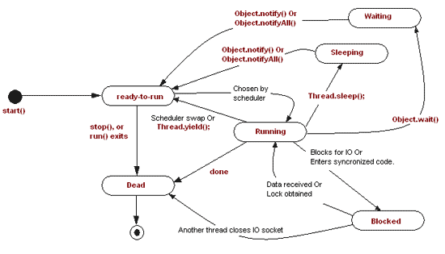
13. Android – Multi-Threading
Multi-Threading
Thread States
Android‘s threads run
in a manner similar to
common Java threads
Thread.State | Description
BLOCKED | The thread is blocked and waiting for a lock.
NEW | The thread has been created, but has never been started.
RUNNABLE | The thread may be run.
TERMINATED | The thread has been terminated.
TIMED_WAITING | The thread is waiting for a specified amount of time.
WAITING | The thread is waiting.
28
28

Slide 29
13. Android – Multi-Threading
Multi-Threading
Using the AsyncTask class
AsyncTask enables proper and easy use of the UI thread.
This class allows to perform background operations and publish results on the UI thread without having to manipulate threads and/or handlers.
An asynchronous task is defined by a computation that runs on a background thread and whose result is published on the UI thread.
An asynchronous task is defined by
3 Generic Types | 4 Main States | 1 Auxiliary Method
Params, Progress, Result | onPreExecute, doInBackground, onProgressUpdate onPostExecute. | publishProgress
29
29
29

Slide 30
13. Android – Multi-Threading
Multi-Threading
Using the AsyncTask class
private class VerySlowTask extends AsyncTask<String, Long, Void> {
// Begin - can use UI thread here
protected void onPreExecute() {
}
// this is the SLOW background thread taking care of heavy tasks
// cannot directly change UI
protected Void doInBackground(final String... args) {
... publishProgress((Long) someLongValue);
}
// periodic updates - it is OK to change UI
@Override
protected void onProgressUpdate(Long... value) {
}
// End - can use UI thread here
protected void onPostExecute(final Void unused) {
}
}
30
30
30

Slide 31
13. Android – Multi-Threading
Multi-Threading
AsyncTask <Params, Progress, Result>
AsyncTask's generic types
Params: the type of the parameters sent to the task upon execution.
Progress: the type of the progress units published during the background computation.
Result: the type of the result of the background computation.
Not all types are always used by an asynchronous task. To mark a type as unused, simply use the type Void
Note:
Syntax “String…” indicates (Varargs) array of String values, similar to “String[]”
31
31
31

Slide 32
13. Android – Multi-Threading
Multi-Threading
AsyncTask's methods
onPreExecute(), invoked on the UI thread immediately after the task is executed. This step is normally used to setup the task, for instance by showing a progress bar in the user interface.
doInBackground(Params...), invoked on the background thread immediately after onPreExecute() finishes executing. This step is used to perform background computation that can take a long time. The parameters of the asynchronous task are passed to this step. The result of the computation must be returned by this step and will be passed back to the last step. This step can also use publishProgress(Progress...) to publish one or more units of progress. These values are published on the UI thread, in the onProgressUpdate(Progress...) step.
onProgressUpdate(Progress...), invoked on the UI thread after a call to publishProgress(Progress...). The timing of the execution is undefined. This method is used to display any form of progress in the user interface while the background computation is still executing. For instance, it can be used to animate a progress bar or show logs in a text field.
onPostExecute(Result), invoked on the UI thread after the background computation finishes. The result of the background computation is passed to this step as a parameter.
32
32
32

Slide 33
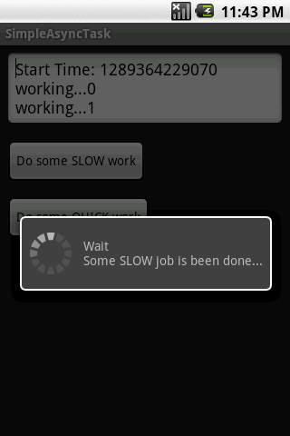
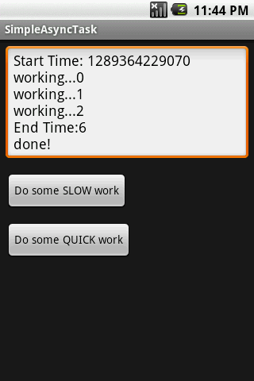
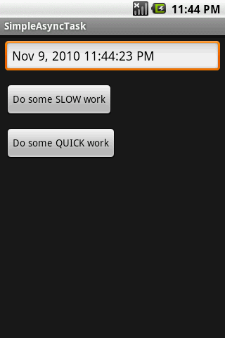
13. Android – Multi-Threading
Multi-Threading
Example: Using the AsyncTask class
The main task invokes an AsyncTask to do some slow job. The AsyncTask methods do the required computation and periodically update the main’s UI. In our the example the background activity negotiates the writing of the lines in the text box, and also controls the circular progress bar.
33
33
33
33

Slide 34
13. Android – Multi-Threading
Multi-Threading
Example: Using the AsyncTask class
public class Main extends Activity {
Button btnSlowWork;
Button btnQuickWork;
EditText etMsg;
Long startingMillis;
@Override
public void onCreate(Bundle savedInstanceState) {
super.onCreate(savedInstanceState);
setContentView(R.layout.main);
etMsg = (EditText) findViewById(R.id.EditText01);
btnSlowWork = (Button) findViewById(R.id.Button01);
// delete all data from database (when delete button is clicked)
this.btnSlowWork.setOnClickListener(new OnClickListener() {
public void onClick(final View v) {
new VerySlowTask().execute();
}
});
btnQuickWork = (Button) findViewById(R.id.Button02);
// delete all data from database (when delete button is clicked)
this.btnQuickWork.setOnClickListener(new OnClickListener() {
public void onClick(final View v) {
etMsg.setText((new Date()).toLocaleString());
}
});
}// onCreate
34
34
34
34

Slide 35
13. Android – Multi-Threading
Multi-Threading
Example: Using the AsyncTask class
private class VerySlowTask extends AsyncTask <String, Long, Void> {
private final ProgressDialog dialog = new ProgressDialog(Main.this);
// can use UI thread here
protected void onPreExecute() {
startingMillis = System.currentTimeMillis();
etMsg.setText("Start Time: " + startingMillis);
this.dialog.setMessage("Wait\nSome SLOW job is being done...");
this.dialog.show();
}
// automatically done on worker thread (separate from UI thread)
protected Void doInBackground(final String... args) {
try {
// simulate here the slow activity
for (Long i = 0L; i < 3L; i++) {
Thread.sleep(2000);
publishProgress((Long)i);
}
} catch (InterruptedException e) {
Log.v("slow-job being done", e.getMessage())
}
return null;
}
35
35
35
35

Slide 36
13. Android – Multi-Threading
Multi-Threading
Example: Using the AsyncTask class
// periodic updates - it is OK to change UI
@Override
protected void onProgressUpdate(Long... value) {
super.onProgressUpdate(value);
etMsg.append("\nworking..." + value[0]);
}
// can use UI thread here
protected void onPostExecute(final Void unused) {
if (this.dialog.isShowing()) {
this.dialog.dismiss();
}
// cleaning-up all done
etMsg.append("\nEnd Time:"
+ (System.currentTimeMillis()-startingMillis)/1000);
etMsg.append("\ndone!");
}
}//AsyncTask
}// Main
36
36
36
36

Slide 37
13. Android – Multi-Threading
Multi-Threading
Example: Using the AsyncTask class
<?xml version="1.0" encoding="utf-8"?>
<LinearLayout xmlns:android="http://schemas.android.com/apk/res/android"
android:orientation="vertical"
android:layout_width="fill_parent"
android:layout_height="fill_parent"
>
<EditText
android:id="@+id/EditText01"
android:layout_width="fill_parent"
android:layout_height="wrap_content"
android:layout_margin="7px" />
<Button
android:text="Do some SLOW work"
android:id="@+id/Button01"
android:layout_width="wrap_content"
android:layout_height="wrap_content"
android:layout_margin="7px" />
<Button
android:text="Do some QUICK work"
android:id="@+id/Button02"
android:layout_width="wrap_content"
android:layout_height="wrap_content"
android:layout_margin="7px" />
</LinearLayout>
37
37
37
37

Slide 38
Android Programming: 2D Drawing Part 1: Using onDraw

Slide 39
Topics in This Section
Extending a View
Using onDraw
Referring to custom View in layout file
Drawing basic shapes with Canvas
Drawing bitmaps (images) with Canvas

Slide 40
Extending a View

Slide 41
Summary: Java
Idea
Extend the View class, put the drawing code in onDraw
Note: this assumes the View is placed in a fixed-size region. In lecture on Custom Components, we will discuss using onMeasure to calculate desired sizes.
Syntax
public class RandomShapeView extends View {
…
protected void onDraw(Canvas canvas) {
super.onDraw(canvas);
canvas.drawBlah(…);
…
}
}

Slide 42
Summary: XML
Idea
Refer to the custom View with the “view” tag in layout file. Pass standard attributes (id, sizes, background).
In lecture on Custom Components, we will discuss passing custom attributes.
Syntax
…
<view
class="com.someCompany.somePackage.YourView"
android:id="…"
android:layout_width="…"
android:layout_height="…" android:background="…" />
…

Slide 43
Using onDraw: Canvas and Paint
Canvas
onDraw is passed a Canvas. Use its drawing methods.
Paint
Most of the drawing methods (drawArc, drawCircle, etc.) take a Paint as an argument. This is different from Swing and the AWT, where you set the paint on the Graphics separately from the drawing methods.
The Paint also incorporates the font size
Making a Paint
Paint p = new Paint();
// Or Paint p = new Paint(Paint.ANTI_ALIAS_FLAG);
p.setColor(…);
p.setTextSize(…);

Slide 44
Common Canvas Drawing Methods
drawColor, drawRGB, drawARGB
Fill entire region with a color. Note that this uses Color, not Paint.
drawBitmap
Draw a picture. Create a Bitmap from an image file via BitmapFactory.decodeResource (getResources(),R.drawable.blah)
drawCircle, drawOval, drawRect, drawRoundRect, drawArc, drawLine
Draw basic shape, usually inside rectangular region
drawText, drawTextOnPath, drawPosText
Draw text in simple or fancy ways. Note that drawPosText is deprecated in recent Android releases.
drawPath
A Path lets you combine multiple shapes into one object

Slide 45
Drawing Images
Put image files in res/drawable
If file is res/drawable/foo_bar.gif, you will refer to it with R.drawable.foo_bar.
You often want versions of your image in various resolutions, so you will put the images in res/drawable-xhdpi (extra high), res/drawable-hdpi (high), res/drawable-mdpi (medium), res/drawable-ldpi (low)
Supported image types are jpeg, gif, png, bmp, and (Android 4.0+ only) webp
Load image into Bitmap
Bitmap pic = BitmapFactory.decodeResource (getResources(), R.drawable.base_name);
Draw Bitmap
canvas.drawBitmap(pic, left, top, null);
The last arg is the Paint (null for opaque images)

Slide 46
Triggering Redrawing
Automatically
After screen is rotated or covered and reexposed
Manually
Yes
Call “invalidate” on the View
If called by Thread other than main thread, you should call “postInvalidate” instead of “invalidate”
No
Call “onDraw” directly
Very simple animation
By repeatedly doing short Thread.sleep, then calling invalidate
For details on fancier animation, see http://developer.android.com/guide/topics/graphics/index.html

Slide 47
Avoid Allocating Drawing Objects in onDraw
Idea
onDraw is expensive
onDraw can be called many times
Consequence
Don’t allocate graphics objects in onDraw
This is especially true of Bitmaps, but applies to Paint and other simpler objects as well

Slide 48
Example: View that Draws Random Shapes

Slide 49
Example Summary
Idea
Make View that draws random backgrounds, circles, rectangles, bitmaps, and text
All sizes and locations based on current dimensions of the View
View must go in fixed-sized region for now. We will discuss using onMeasure to request sizes in section on Custom Components
Redrawing triggered by button in main Activity
Gets id of custom View, calls findViewById, then calls invalidate on each button press

Slide 50
View: General Class Structure
To avoid repeated allocation, objects like Paint and Bitmap objects should be instantiated once per View instantiation (i.e., as instance variable values or in the constructor).
public class RandomShapeView extends View {
private Integer[] mBackgrounds = { ... };
private Paint[] mForegrounds = { ... };
private Bitmap[] mPics = { ... };
private String mMessage = "Android";
public RandomShapeView(Context context) {
super(context);
}
public RandomShapeView(Context context, AttributeSet attrs) {
super(context, attrs);
}
@Override
protected void onDraw(Canvas canvas) {
super.onDraw(canvas);
...
}
...
}

Slide 51
View: onDraw
public class RandomShapeView extends View {
...
@Override
protected void onDraw(Canvas canvas) {
super.onDraw(canvas);
canvas.drawColor(RandomUtils.randomElement(mBackgrounds));
int viewWidth = getWidth();
int viewHeight = getHeight();
int avgShapeWidth = viewWidth/5;
for(int i=0; i<20; i++) {
drawRandomCircle(canvas, viewWidth,
viewHeight, avgShapeWidth);
drawRandomRect(canvas, viewWidth,
viewHeight, avgShapeWidth);
drawRandomBitmap(canvas, viewWidth, viewHeight);
drawRandomText(canvas, viewWidth,
viewHeight, avgShapeWidth);
}
}
}
You must call getWidth and getHeight in onDraw (or after), not in the constructor. However, to avoid repeated allocation, “real” objects like Paint and Bitmap objects should not be instantiated in onDraw.

Slide 52
View: Random Background Colors
public class RandomShapeView extends View {
private Integer[] mBackgrounds =
{ Color.CYAN, Color.GRAY, Color.LTGRAY,
Color.MAGENTA, Color.YELLOW, Color.WHITE };
...
@Override
protected void onDraw(Canvas canvas) {
super.onDraw(canvas);
canvas.drawColor(RandomUtils.randomElement(mBackgrounds));
...
}
}
Notice that in Android, colors are really ints, as opposed to AWT and Swing where colors are real Objects. Also note that you draw backgrounds with colors, not Paints.

Slide 53
View: Random Circles
public class RandomShapeView extends View {
private Paint[] mForegrounds =
{ makePaint(Color.BLACK), makePaint(Color.BLUE),
makePaint(Color.GREEN), makePaint(Color.RED) };
...
private void drawRandomCircle(Canvas canvas, int viewWidth,
int viewHeight, int avgShapeWidth) {
float x = RandomUtils.randomFloat(viewWidth);
float y = RandomUtils.randomFloat(viewHeight);
float radius = RandomUtils.randomFloat(avgShapeWidth/2);
Paint circleColor = RandomUtils.randomElement(mForegrounds);
canvas.drawCircle(x, y, radius, circleColor);
}
private Paint makePaint(int color) {
Paint p = new Paint();
p.setColor(color);
return(p);
}
}
drawRandomCircle is called from the loop in onDraw. Note that the Paint objects are not allocated in onDraw, but rather just once per class instantiation.

Slide 54
View: Random Rectangles
public class RandomShapeView extends View {
private Paint[] mForegrounds =
{ makePaint(Color.BLACK), makePaint(Color.BLUE),
makePaint(Color.GREEN), makePaint(Color.RED) };
...
private void drawRandomRect(Canvas canvas, int viewWidth,
int viewHeight, int avgShapeWidth) {
float left = RandomUtils.randomFloat(viewWidth);
float top = RandomUtils.randomFloat(viewHeight);
float width = RandomUtils.randomFloat(avgShapeWidth);
float right = left + width;
float bottom = top + width;
Paint squareColor = RandomUtils.randomElement(mForegrounds);
canvas.drawRect(left, top, right, bottom, squareColor);
}
}

Slide 55
View: Random Bitmaps
public class RandomShapeView extends View {
private Bitmap[] mPics =
{ makeBitmap(R.drawable.emo_im_angel),
makeBitmap(R.drawable.emo_im_cool),
makeBitmap(R.drawable.emo_im_crying),
makeBitmap(R.drawable.emo_im_happy),
makeBitmap(R.drawable.emo_im_yelling) };
...
private void drawRandomBitmap(Canvas canvas, int viewWidth,
int viewHeight) {
float left = RandomUtils.randomFloat(viewWidth);
float top = RandomUtils.randomFloat(viewHeight);
Bitmap pic = RandomUtils.randomElement(mPics);
// Last arg is the Paint: you can use null for opaque images
canvas.drawBitmap(pic, left, top, null);
}
private Bitmap makeBitmap(int bitmapId) {
return(BitmapFactory.decodeResource(getResources(), bitmapId));
}
}

Slide 56
Random Text
public class RandomShapeView extends View {
private String mMessage = "Android";
...
private void drawRandomText(Canvas canvas, int viewWidth,
int viewHeight, int avgShapeWidth) {
float x = RandomUtils.randomFloat(viewWidth);
float y = RandomUtils.randomFloat(viewHeight);
float textSize = RandomUtils.randomFloat(avgShapeWidth);
Paint textPaint = RandomUtils.randomElement(mForegrounds);
textPaint.setTextSize(textSize);
canvas.drawText(mMessage, x, y, textPaint);
}
}

Slide 57
Helper Class: Random Utilities
public class RandomUtils {
private static Random r = new Random();
public static int randomInt(int range) {
return(r.nextInt(range));
}
public static int randomIndex(Object[] array) {
return(randomInt(array.length));
}
public static <T> T randomElement(T[] array) {
return(array[randomIndex(array)]);
}
public static float randomFloat(int n) {
return((float)Math.random()*n);
}
}

Slide 58
Layout File for Example (activity_draw_shapes1.xml)
<LinearLayout
xmlns:android="http://schemas.android.com/apk/res/android"
xmlns:tools="http://schemas.android.com/tools"
android:id="@+id/LinearLayout1"
android:layout_width="match_parent"
android:layout_height="match_parent"
android:orientation="vertical" >
<Button
android:onClick="redraw"
android:layout_width="match_parent"
android:layout_height="wrap_content"
android:text="@string/redraw_button_label" />
<view
class="com.coreservlets.drawing.RandomShapeView"
android:id="@+id/drawing_area"
android:layout_width="match_parent"
android:layout_height="match_parent" />
</LinearLayout>

Slide 59
Activity for Example
public class DrawShapes1 extends Activity {
private RandomShapeView mDrawingArea;
@Override
public void onCreate(Bundle savedInstanceState) {
super.onCreate(savedInstanceState);
setContentView(R.layout.activity_draw_shapes1);
mDrawingArea =
(RandomShapeView)findViewById(R.id.drawing_area);
}
/** Handles events for the button. Redraws the ShapeView. */
public void redraw(View clickedButton) {
mDrawingArea.invalidate();
}
}

Slide 60
Overall Main Layout File (main.xml)
<LinearLayout ... android:orientation="vertical">
<Button
android:onClick="launchDrawShapes1"
android:layout_width="match_parent"
android:layout_height="wrap_content"
android:text="@string/random_shape_button_label" />
<Button
android:onClick="launchRotate"
android:layout_width="match_parent"
android:layout_height="wrap_content"
android:text="@string/rotate_button_label" />
<Button
android:onClick="launchSkew"
android:layout_width="match_parent"
android:layout_height="wrap_content"
android:text="@string/skew_button_label" />
<Button
android:onClick="launchDrawShapes2"
android:layout_width="match_parent"
android:layout_height="wrap_content"
android:text="@string/shape_drawable_button_label" />
</LinearLayout>

Slide 61
Overall Main Activity
public class DrawingExampleLauncher extends Activity {
@Override
public void onCreate(Bundle savedInstanceState) {
super.onCreate(savedInstanceState);
setContentView(R.layout.main);
}
public void launchDrawShapes1(View clickedButton) {
Intent activityIntent =
new Intent(this, DrawShapes1.class);
startActivity(activityIntent);
}
// Similar button-handling code for
// other three drawing examples
}

Slide 62
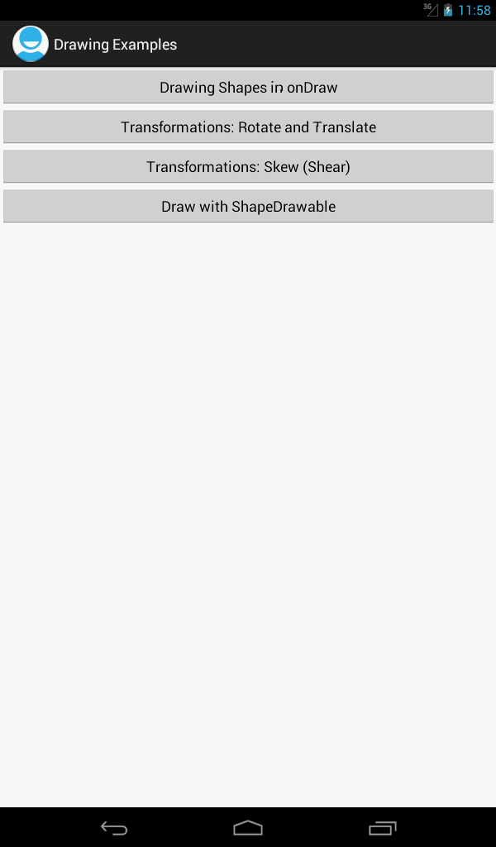
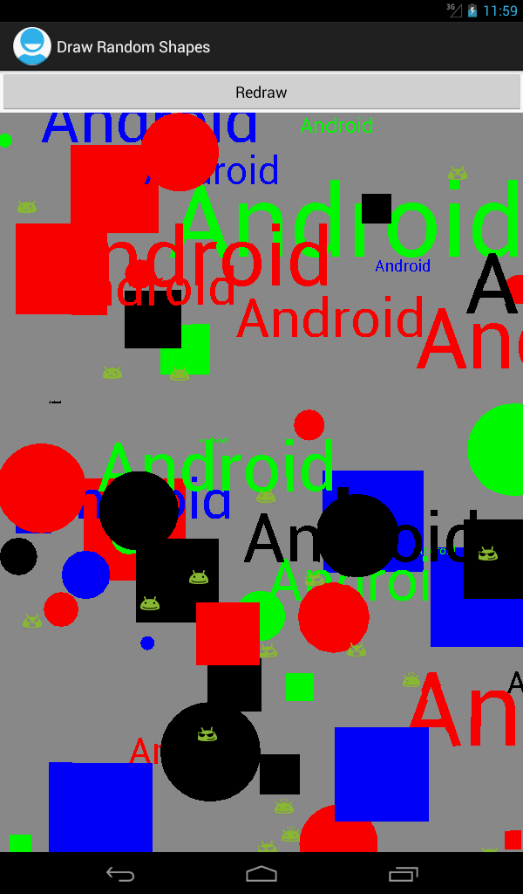
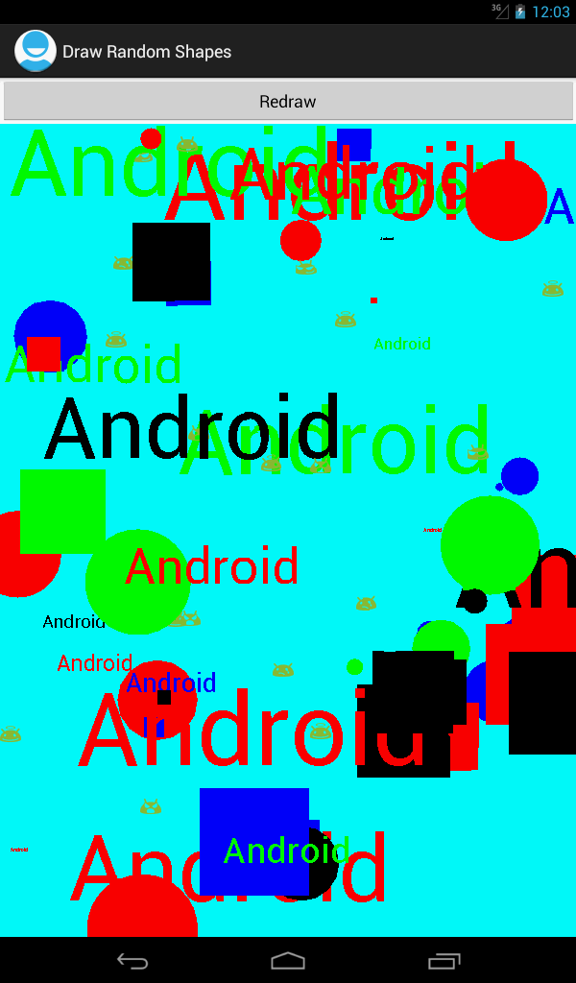
Results

Slide 63
Android Programming: 2D Drawing Part 2: Coordinate Transformations and ShapeDrawable

Slide 64
Topics in This Section
Canvas coordinate transformations
translate
rotate
skew
scale
Using ShapeDrawable
Motivation
Making a ShapeDrawable
Drawing a ShapeDrawable

Slide 65
Coordinate Transformations

Slide 66
Summary
Idea
Instead of computing new coordinates, move the coordinate system itself.
For example, to draw text on clock face, don’t rotate and position each string. Instead, translate to center, rotate Canvas 22.5 degrees, then draw string in same place.
Java Syntax
protected void onDraw(Canvas canvas) {
super.onDraw(canvas);
canvas.translate(…);
canvas.rotate(…);
canvas.scale(…);
canvas.skew(…);
canvas.drawBlah(…);
}

Slide 67
Coordinate Transformations: Available Operations
translate
Move drawing. Positive x means to move drawing to the right
rotate
Spin around current center, which can be changed by translate. In degrees, unlike Java 2D (desktop Java) which uses radians
scale
Stretch evenly.
skew
Stretch more as points get further from origin.
Called “shear” in some other libraries.
concat/setMatrix
Do several transformations to Matrix, then apply Matrix. Usually use “concat” to add Matrix to existing one, rather than “setMatrix” to reset.
save/restore
Save/restore the current transformation Matrix. Rather than reversing a long series of transformations, just save, do the transformations, then restore.

Slide 68
Example: Rotated Text

Slide 69
Example Summary
Idea
Make View that draws text rotated around a central point
Uses “translate” to shift the origin to the center of the View
Then uses “rotate” to spin around that point
Draws the strings with drawText
Uses anti-aliasing in the Paint
Uses a fixed-size font
So, just making a guess about what text size will fit. In section on Custom Components, We will discuss several improvements to this approach
Change the font size to fit the window
Let the XML file specify the font size
Use onMeasure to compute desired sizes, so that the View does not have to be in fixed-size region (i.e., it can use wrap_content instead of match_parent)

Slide 70
View: General Class Structure
public class RotateTextView extends View {
private Paint mPaint = makePaint(Color.BLUE);
private String mMessage = "Android";
public RotateTextView(Context context) {
super(context);
}
public RotateTextView(Context context, AttributeSet attrs) {
super(context, attrs);
}
@Override
protected void onDraw(Canvas canvas) {
super.onDraw(canvas);
...
}
...
}

Slide 71
View: onDraw
public class RotateTextView extends View {
...
@Override
protected void onDraw(Canvas canvas) {
super.onDraw(canvas);
int viewWidth = getWidth();
int viewHeight = getHeight();
canvas.translate(viewWidth/2, viewHeight/2);
for(int i=0; i<10; i++) {
canvas.drawText(mMessage, 0, 0, mPaint);
canvas.rotate(36);
}
}
...
}
Remember that rotate uses degrees, whereas Java 2D in desktop Java uses radians.

Slide 72
View: Making the Paint
public class RotateTextView extends View {
private Paint mPaint = makePaint(Color.BLUE);
private String mMessage = "Android";
...
private Paint makePaint(int color) {
Paint p = new Paint(Paint.ANTI_ALIAS_FLAG);
p.setColor(color);
p.setTextSize(50);
return(p);
}
}
Angled lines look better with anti-aliasing.

Slide 73
Layout File for Example (activity_rotate.xml)
<LinearLayout
xmlns:android="http://schemas.android.com/apk/res/android"
xmlns:tools="http://schemas.android.com/tools"
android:id="@+id/LinearLayout1"
android:layout_width="match_parent"
android:layout_height="match_parent" >
<view
class="com.coreservlets.drawing.RotateTextView"
android:layout_width="match_parent"
android:layout_height="match_parent" />
</LinearLayout>

Slide 74
Activity for Example
public class RotateActivity extends Activity {
@Override
public void onCreate(Bundle savedInstanceState) {
super.onCreate(savedInstanceState);
setContentView(R.layout.activity_rotate);
}
}

Slide 75
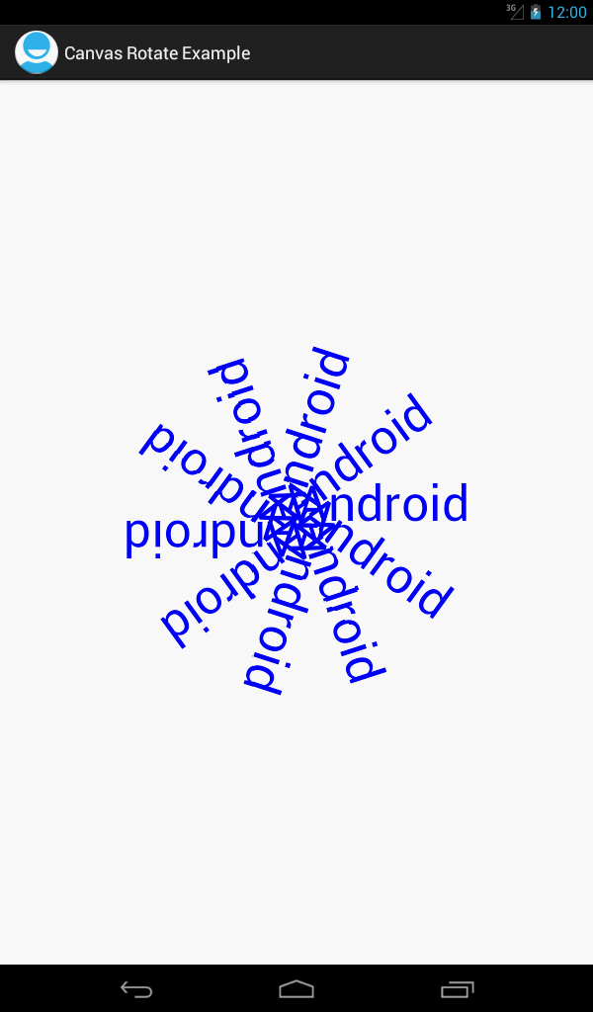
Results

Slide 76
Example: Skew

Slide 77
Example Summary
Idea
Make View that draws rectangles with various amounts of x skew
Meaning of skew
X skew If you specify a non-zero x skew, then x values will be more and more shifted to the right the farther they go in the y direction. For example, an x skew of 0.1 means that the x value will be shifted 10% of the distance the point is away from the x axis.
Y skew Points are shifted down in proportion to the distance they are to the right (x direction) from the y axis.

Slide 78
View: General Class Structure
public class SkewShapeView extends View {
private Paint mBlackPaint = makePaint(Color.BLUE);
public SkewShapeView(Context context) {
super(context);
}
public SkewShapeView(Context context, AttributeSet attrs) {
super(context, attrs);
}
@Override
protected void onDraw(Canvas canvas) {
super.onDraw(canvas);
...
}
...
}

Slide 79
View: onDraw
@Override
protected void onDraw(Canvas canvas) {
super.onDraw(canvas);
int viewWidth = getWidth();
int viewHeight = getHeight();
int deltaW = viewWidth/36;
int rectWidth = 4*deltaW;
int deltaH = 5;
int rectHeight = viewHeight-2*deltaH;
int left = deltaW;
int top = deltaH;
for(int i=0; i<5; i++) {
canvas.drawRect(left, top, left+rectWidth,
top+rectHeight, mBlackPaint);
left = left+6*deltaW;
canvas.skew(0.1f, 0);
}
}

Slide 80
View: Making the Paint
public class SkewShapeView extends View {
private Paint mBlackPaint = makePaint(Color.BLUE);
...
private Paint makePaint(int color) {
Paint p = new Paint(Paint.ANTI_ALIAS_FLAG);
p.setColor(color);
p.setTextSize(50);
return(p);
}
}
Again, angled lines look better with anti-aliasing.

Slide 81
Layout File for Example (activity_skew.xml)
<LinearLayout
xmlns:android="http://schemas.android.com/apk/res/android"
xmlns:tools="http://schemas.android.com/tools"
android:id="@+id/LinearLayout1"
android:layout_width="match_parent"
android:layout_height="match_parent" >
<view
class="com.coreservlets.drawing.SkewShapeView"
android:layout_width="match_parent"
android:layout_height="match_parent" />
</LinearLayout>

Slide 82
Activity for Example
public class SkewActivity extends Activity {
@Override
public void onCreate(Bundle savedInstanceState) {
super.onCreate(savedInstanceState);
setContentView(R.layout.activity_skew);
}
}

Slide 83
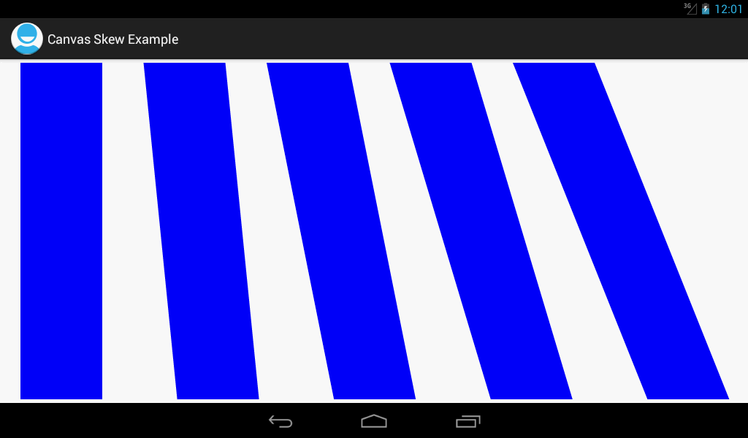
Results
With s skew, points are shifted to the right the further they are down in the y direction. There is no y skew in this example.

Slide 84
Using ShapeDrawable

Slide 85
Summary: Idea
Idea
Instead of directly using canvas.drawBlah, make a ShapeDrawable object, then tell it to draw itself on the Canvas.
Advantages
By keeping a List of ShapeDrawable objects and having onDraw draw them all, you can
“Remember” the drawings when onDraw is re-invoked
E.g., after invalidate
Remove some of the drawings later
E.g., based on user actions. Note that ShapeDrawable has a getBounds() method, and Bounds has a contains(x,y) method.
Change the characteristics of the drawings later
E.g., keep same shape but change colors

Slide 86
Summary: Java Syntax
Making shapes
public boolean onSomeUserEvent(BlahEvent event) {
Shape shape = new OvalShape(…); // Or other Shape
ShapeDrawable shapeD = new ShapeDrawable(shape);
shapeD.setBounds(…);
shapeD.getPaint().setColor(…);
shapeList.add(shapeD);
invalidate();
return(true);
}
Drawing shapes
protected void onDraw(Canvas canvas) {
super.onDraw(canvas);
for(ShapeDrawable shape: shapes) {
shape.draw(canvas);
}
}

Slide 87
Example: Pressing to Add or Delete Shapes

Slide 88
Example Summary
Idea
When user touches screen on empty space
Make a ShapeDrawable
Add it to List
Call invalidate (triggers onDraw)
When user touches screen on top of existing shape
Loop down List of ShapeDrawables
Check if touch position is inside bounds
If so, remove shape from List
If not, add a new shape as above
Call invalidate (triggers onDraw)
onDraw
Loops down List of ShapeDrawables and draws them all

Slide 89
View: General Class Structure and onDraw
public class ShapeDrawableView extends View {
private List<ShapeDrawable> shapes =
new ArrayList<ShapeDrawable>();
private Integer[] mColors =
{ Color.BLACK, Color.BLUE, Color.GREEN, Color.RED };
public ShapeDrawableView(Context context) {
super(context);
}
public ShapeDrawableView(Context context, AttributeSet attrs) {
super(context, attrs);
}
@Override
protected void onDraw(Canvas canvas) {
super.onDraw(canvas);
for(ShapeDrawable shape: shapes) {
shape.draw(canvas);
}
}
...

Slide 90
View: Handling Touch Events
@Override
public boolean onTouchEvent(MotionEvent event) {
if (event.getAction() == MotionEvent.ACTION_DOWN) {
int x = (int)event.getX();
int y = (int)event.getY();
if (!isDeletingExistingShape(x, y)) {
shapes.add(makeShapeDrawable(x, y));
}
invalidate();
return (true); // Handled touch event
} else {
return (false); // Did not handle touch event
}
}

Slide 91
View: Removing Existing Shapes
private boolean isDeletingExistingShape(int x, int y) {
for(ShapeDrawable shape: shapes) {
Rect bounds = shape.getBounds();
if (bounds.contains(x, y)) {
shapes.remove(shape);
return(true);
}
}
return(false);
}

Slide 92
View: Making ShapeDrawable Objects
private ShapeDrawable makeShapeDrawable(int x, int y) {
int maxWidth = getWidth()/10;
int maxHeight = getHeight()/10;
Shape shape;
if (Math.random() < 0.5) {
shape = new OvalShape();
} else {
shape = new RectShape();
}
ShapeDrawable shapeD = new ShapeDrawable(shape);
int width = RandomUtils.randomInt(maxWidth)+5;
int height = RandomUtils.randomInt(maxHeight)+5;
shapeD.setBounds(x-width/2, y-height/2,
x+width/2, y+height/2);
shapeD.getPaint().setColor
(RandomUtils.randomElement(mColors));
return(shapeD);
}

Slide 93
Layout File for Example (activity__draw_shapes2.xml)
<LinearLayout
xmlns:android="http://schemas.android.com/apk/res/android"
xmlns:tools="http://schemas.android.com/tools"
android:id="@+id/LinearLayout1"
android:layout_width="match_parent"
android:layout_height="match_parent" >
<TextView
android:layout_width="wrap_content"
android:layout_height="wrap_content"
android:textAppearance=
"?android:attr/textAppearanceMedium"
android:text="@string/heading_activity_draw_shapes2" />
<view
class="com.coreservlets.drawing.ShapeDrawableView"
android:layout_width="match_parent"
android:layout_height="match_parent" />
</LinearLayout>

Slide 94
Activity for Example
public class DrawShapes2 extends Activity {
@Override
public void onCreate(Bundle savedInstanceState) {
super.onCreate(savedInstanceState);
setContentView(R.layout.activity_draw_shapes2);
}
}

Slide 95
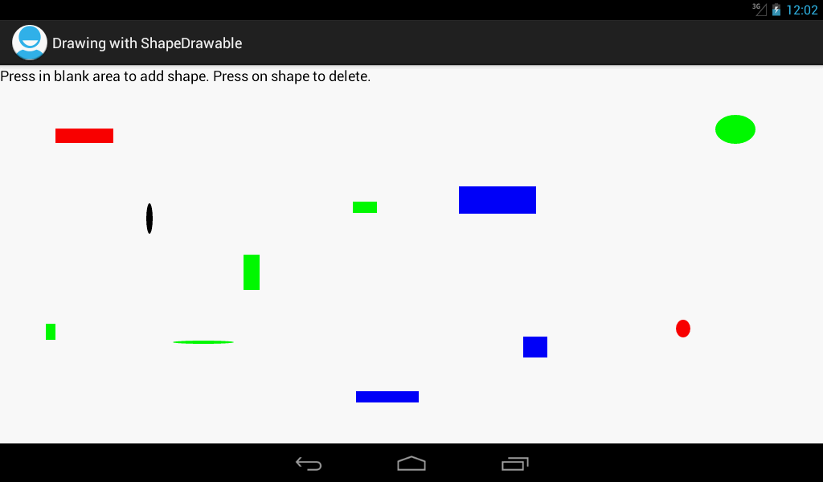
Results
Touching the screen (clicking if using emulator) on an empty area results in a new shape appearing under where you touched. Touching an existing shape deletes it.

Slide 96
Wrap-Up

Slide 97
Summary
Coordinate transformations
canvas.translate(…)
canvas.rotate(…)
canvas.scale(…)
canvas.skew(…)
ShapeDrawable
Event handler
Make a ShapeDrawable based on a Shape
Adjust its characteristics
Add it to a List
Call invalidate
onDraw
Loop down List and draw each ShapeDrawable

Slide 98
Questions?

